Slide 1
Topics
Question answering at Bing
Conversational question understanding

Slide 2
Going to be high level…

Slide 3

Queston Answering at Bing
Microsoft AI and Research – Core Relevance

Slide 4
About Us
Team: Core Relevance
Who: Researchers and engineers
Where: Sunnyvale, California, USA
Working on: Improving relevance of search results, currently focusing on question answering and conversational search

Slide 5
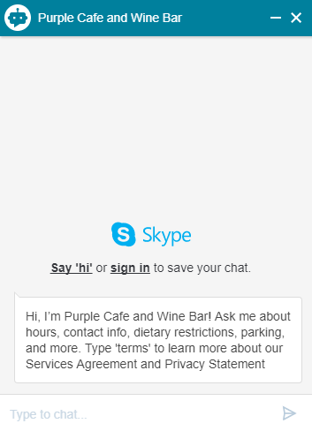
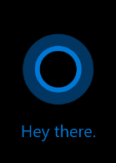
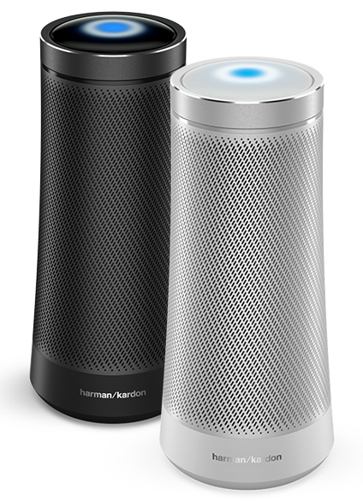

Motivation
Chatbots, digital personal assistants, smart home devices, etc.
More conversational interactions between humans and machines
🤖📱
💻🔈
🗣

Slide 6
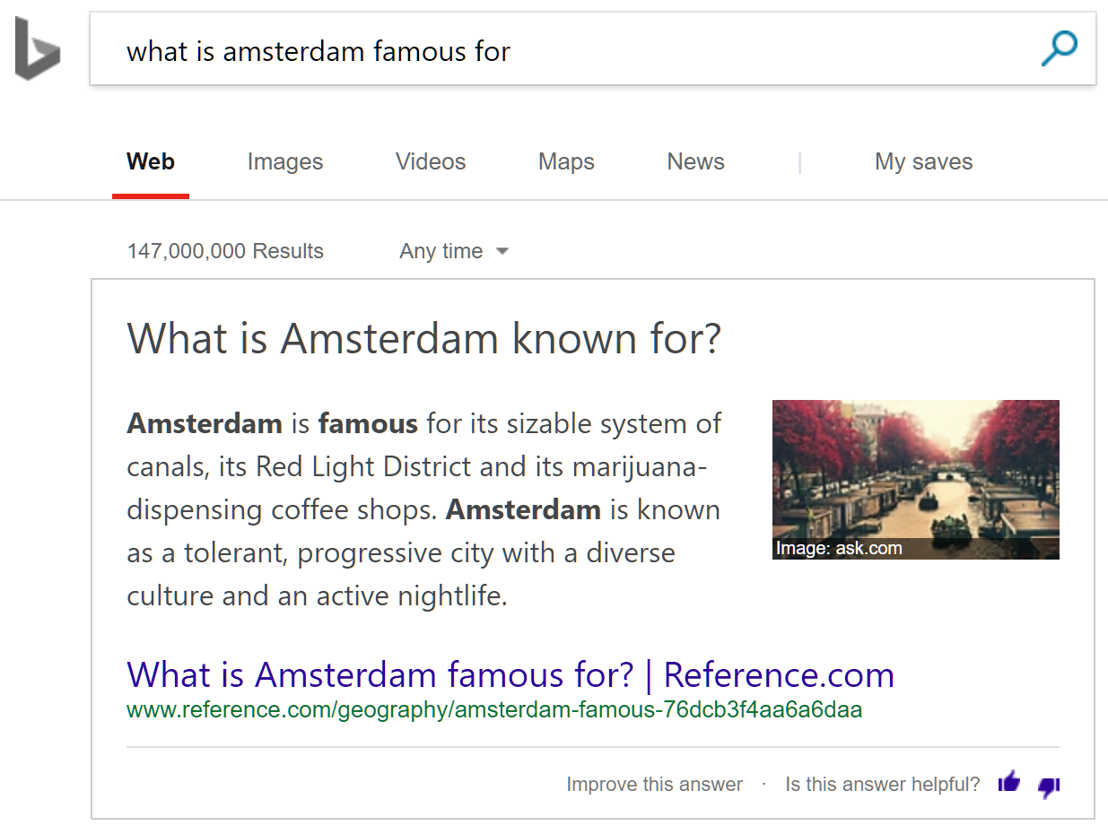
QnA on Bing.com

Slide 7
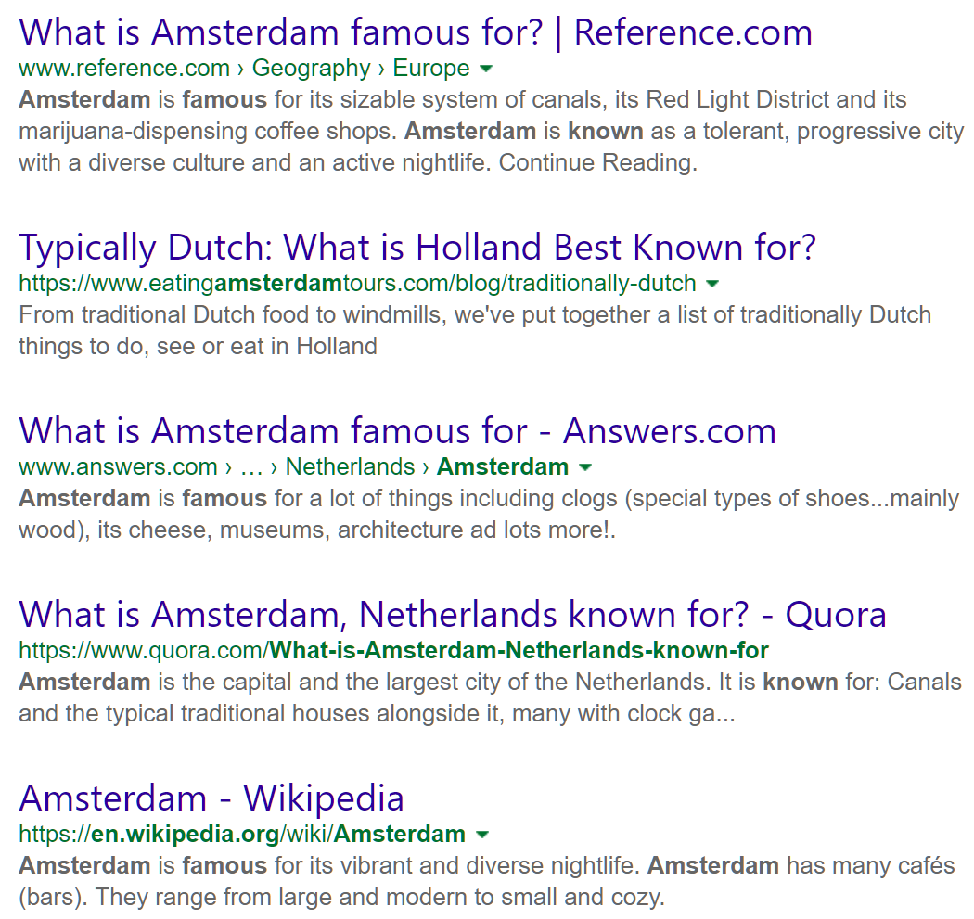
QnA on Bing.com

Slide 8
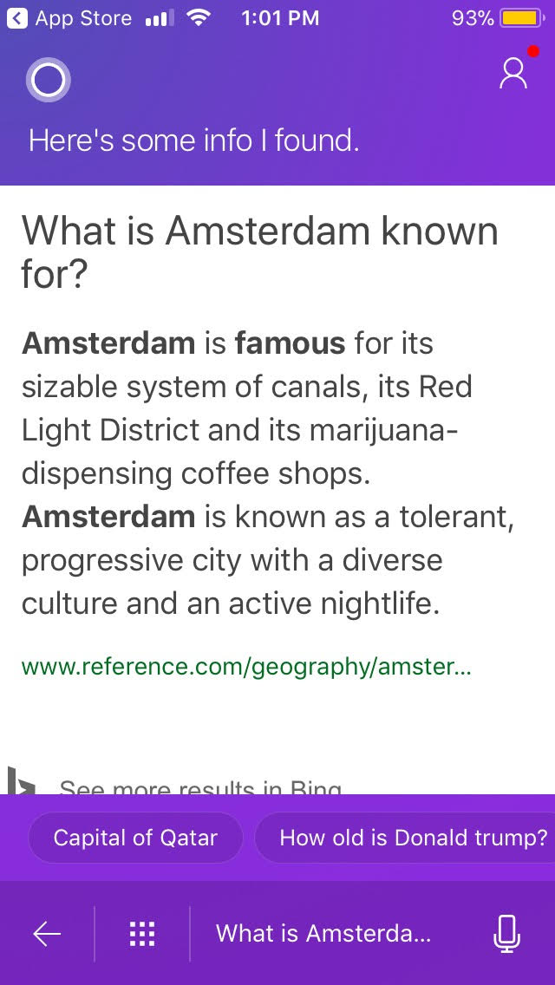
QnA on Cortana

Slide 9
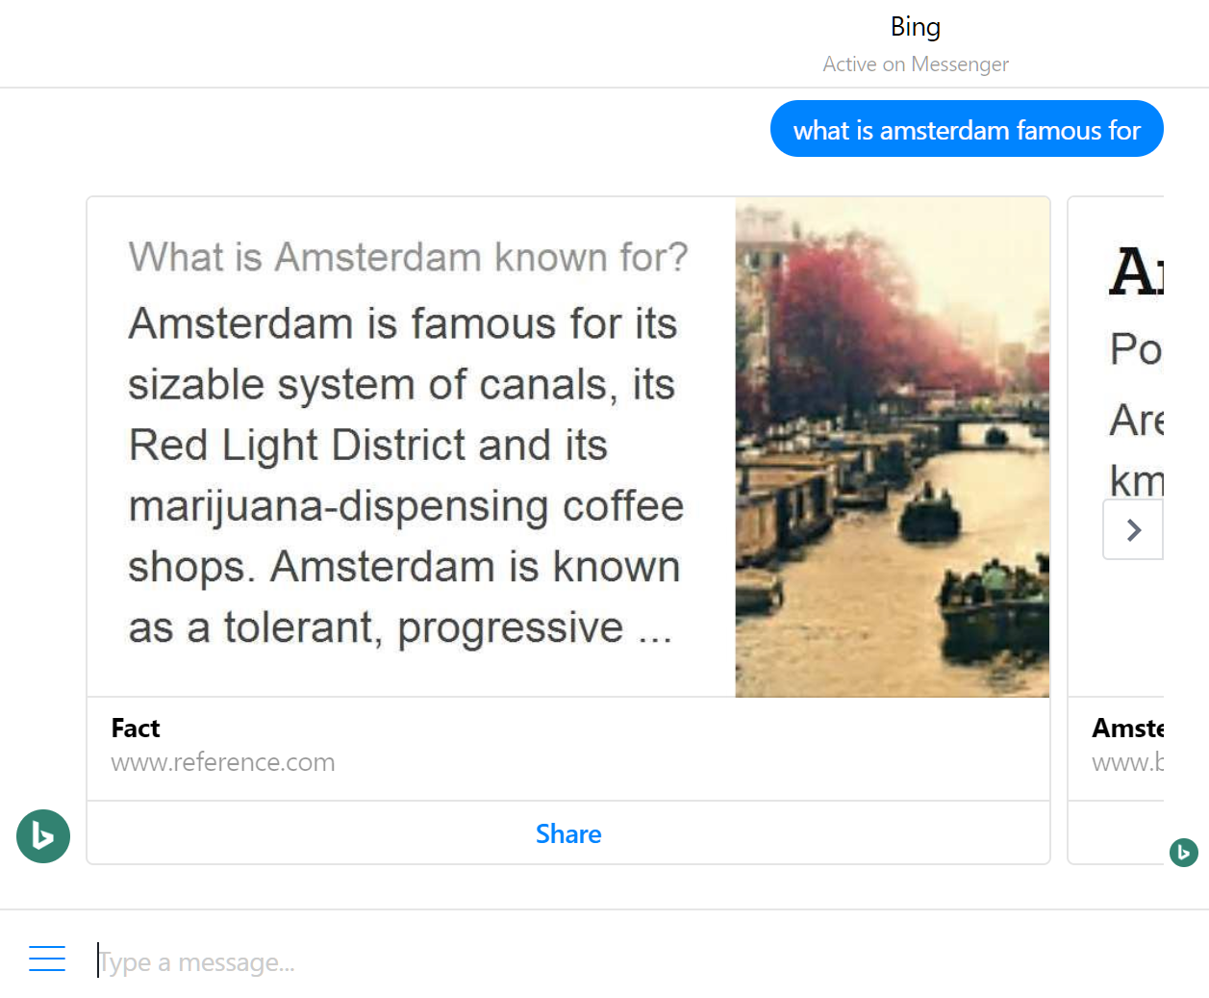
QnA on FB Messenger

Slide 10
MS MARCO
Microsoft MAchine Reading COmprehension Dataset
http://www.msmarco.org/
Contains:
queries
real anonymized user queries
passages
extracted from real web documents retrieved by Bing for the corresponding query
answers
human generated, also mark which passages were used as supporting evidence

Slide 11
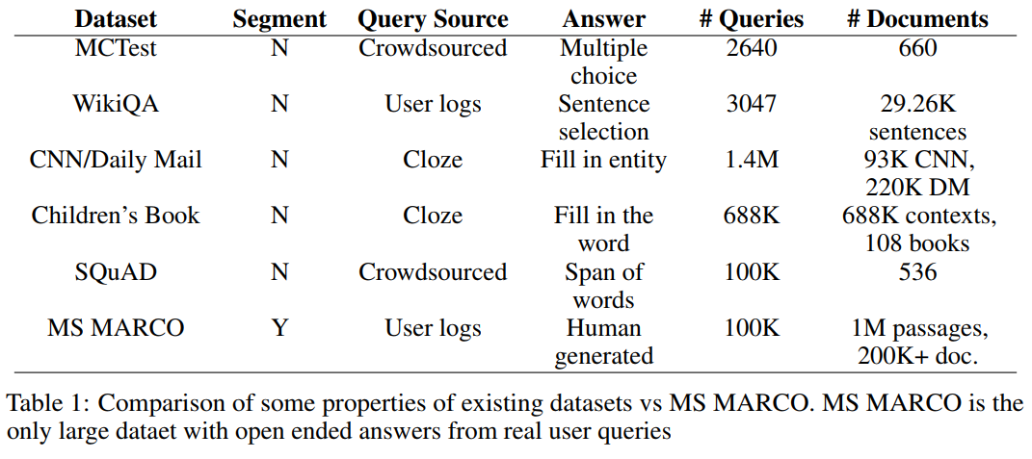
MS MARCO

Slide 12
MS MARCO
“Building intelligent agents with the ability for reading comprehension (RC) or open-domain question answering (QA) over real world data is a major goal of artificial intelligence. Such agents can have tremendous value for consumers because they can power personal assistants such as Cortana [3], Siri [6], Alexa [1], or Google Assistant [4] found on phones or headless devices like Amazon Echo [2], all of which have been facilitated by recent advances in deep speech recognition technology [18, 9]. As these types of assistants rise in popularity, consumers are finding it more convenient to ask a question and quickly get an answer through voice assistance as opposed to navigating through a search engine result page and web browser. Intelligent agents with RC and QA abilities can also have incredible business value by powering bots that automate customer service agents for business found through messaging or chat interfaces.”

Slide 13
SQuAD Leaderboard
https://rajpurkar.github.io/SQuAD-explorer/
Microsoft
Google
Saleforce
Facebook
IBM
Alibaba

Slide 14
QnA Companies = $$$
Maluuba
https://techcrunch.com/2017/01/13/microsoft-acquires-maluuba-a-startup-focused-on-general-artificial-intelligence/
Metamind
https://techcrunch.com/2016/04/04/saleforce-acquires-metamind/
Ozlo
https://techcrunch.com/2017/07/31/facebook-buys-ozlo-to-boost-its-conversational-ai-efforts/

Slide 15
IR more important than ever
Question
Passage
Answer

Slide 16
IR more important than ever
Question
Document
Answer

Slide 17
IR more important than ever
Question
Index of Documents
Answer
IR

Slide 18
Task

Slide 19
Conversational Question Understanding Using Web Knowledge
Gary Ren, Manish Malik, Xiaochuan Ni, Qifa Ke, Nilesh Bhide
Microsoft AI and Research – Core Relevance

Slide 20
Task
Conversational question = question that depends on the context of the current conversation
Ex: “When was Microsoft founded?” → “Who founded it?” → “What is the stock price?”
Conversational question understanding (CQU)
Determine whether or not question depends on previous context
If so, reformulate the question to include the correct context

Slide 21
Challenges
Grammatically incorrect questions
Coreference resolution is hard
beyond just conference resolution!

Slide 22
Solution
Previous Q&A, current Q
Parse Context
NLP
Entities
Entity properties
prev question: Is Microsoft in Seattle?
prev answer: Yes
current question: Who is its mayor?
Generate Reformulations
Heuristics model
Deep model
Original: Who is its mayor?
R₁: Who is Microsoft’s mayor?
R₂: Who is Seattle’s mayor?
Original
R₁
R_{n}
R_{n+1}
Select Best Reformulation
selected reformulation: Who is Seattle’s mayor?
Web knowledge
Current Q reformulated

Slide 23
Parse Context
Previous Q&A, current Q
Parse Context
NLP
Entities
Entity properties
prev question: Is Microsoft in Seattle?
prev answer: Yes
current question: Who is its mayor?
Generate Reformulations
Heuristics model
Deep model
Original: Who is its mayor?
R₁: Who is Microsoft’s mayor?
R₂: Who is Seattle’s mayor?
Original
R₁
R_{n}
R_{n+1}
Select Best Reformulation
selected reformulation: Who is Seattle’s mayor?
Web knowledge
Current Q reformulated

Slide 24
Generate Reformulations
Previous Q&A, current Q
Parse Context
NLP
Entities
Entity properties
prev question: Is Microsoft in Seattle?
prev answer: Yes
current question: Who is its mayor?
Generate Reformulations
Heuristics model
Deep model
Original: Who is its mayor?
R₁: Who is Microsoft’s mayor?
R₂: Who is Seattle’s mayor?
Original
R₁
R_{n}
R_{n+1}
Select Best Reformulation
selected reformulation: Who is Seattle’s mayor?
Web knowledge
Current Q reformulated

Slide 25
Deep Model
Dataset from search engine logs
Query sessions consisting of:
query1
query2 (depends on context from query1)
query3 (reformulation of query2 to include context)
Ex:
query1 = “Is Microsoft in Seattle?”
query2 = “Who is its mayor?”
query3 = “Who is Seattle’s mayor?”

Slide 26
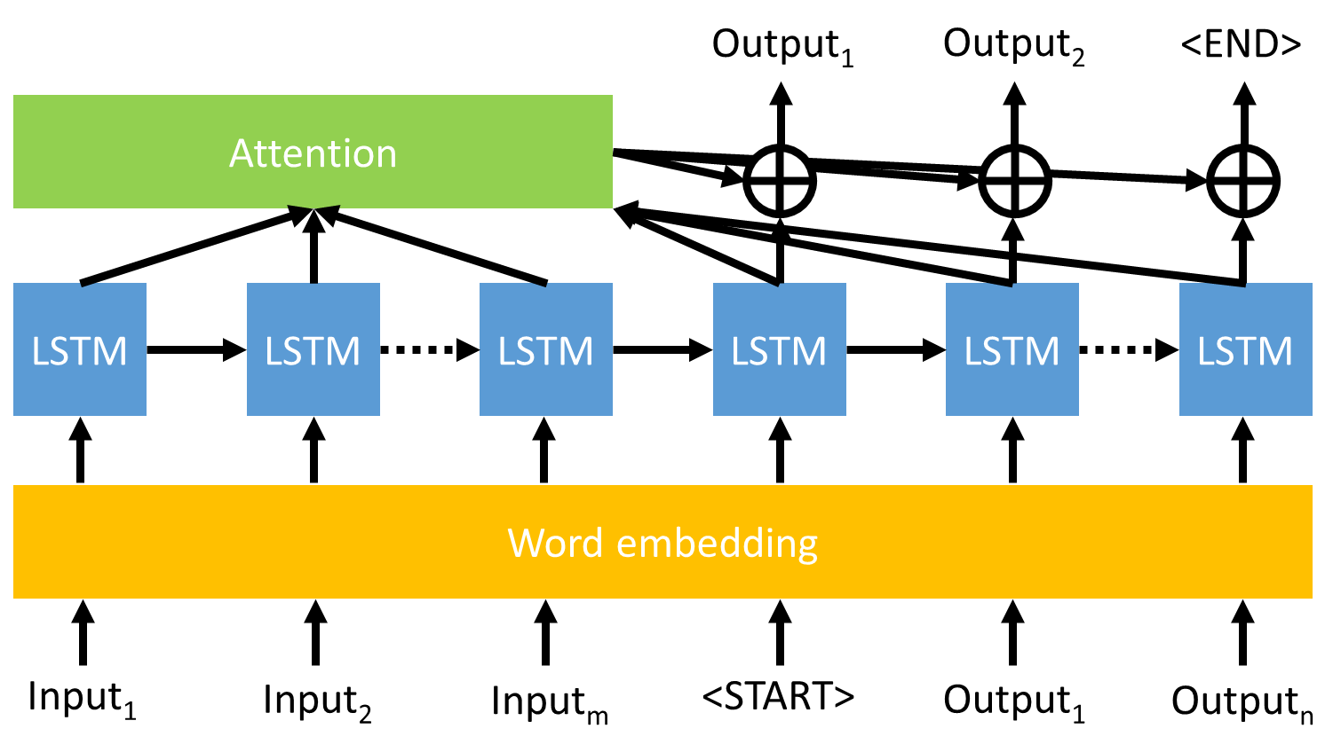
Deep Model
Input = query1, query 2; Output = query3
Sequence to sequence with attention
Encoder
Decoder

Slide 27
Deep Model
Sample query session using trained model, with answers from Bing
Q: Where is amsterdam?
A: North Holland, Netherlands
Q: What is its weather? → What is amsterdam weather?
A: 15°C
Q: Who is the mayor? → Who is the mayor of amsterdam?
A: Eberhard van der Laan
Q: How to split string in python?
A: split()
Q: How to read file? → How to read file in python?
A: open()
Sample query session using trained model, with answers from Bing
Q: How tall is kobe bryant?
A: 6’6”
Q: When was he born? → When was kobe bryant born?
A: August 23, 1978
Q: What are the differences between bacteria and virus?
A: The differences are…
Q: What are the similarities? → What are the similarities between bacteria and virus?
A: The similarities are…

Slide 28
Select Best Reformulation
Previous Q&A, current Q
Parse Context
NLP
Entities
Entity properties
prev question: Is Microsoft in Seattle?
prev answer: Yes
current question: Who is its mayor?
Generate Reformulations
Heuristics model
Deep model
Original: Who is its mayor?
R₁: Who is Microsoft’s mayor?
R₂: Who is Seattle’s mayor?
Original
R₁
R_{n}
R_{n+1}
Select Best Reformulation
selected reformulation: Who is Seattle’s mayor?
Web knowledge
Current Q reformulated

Slide 29
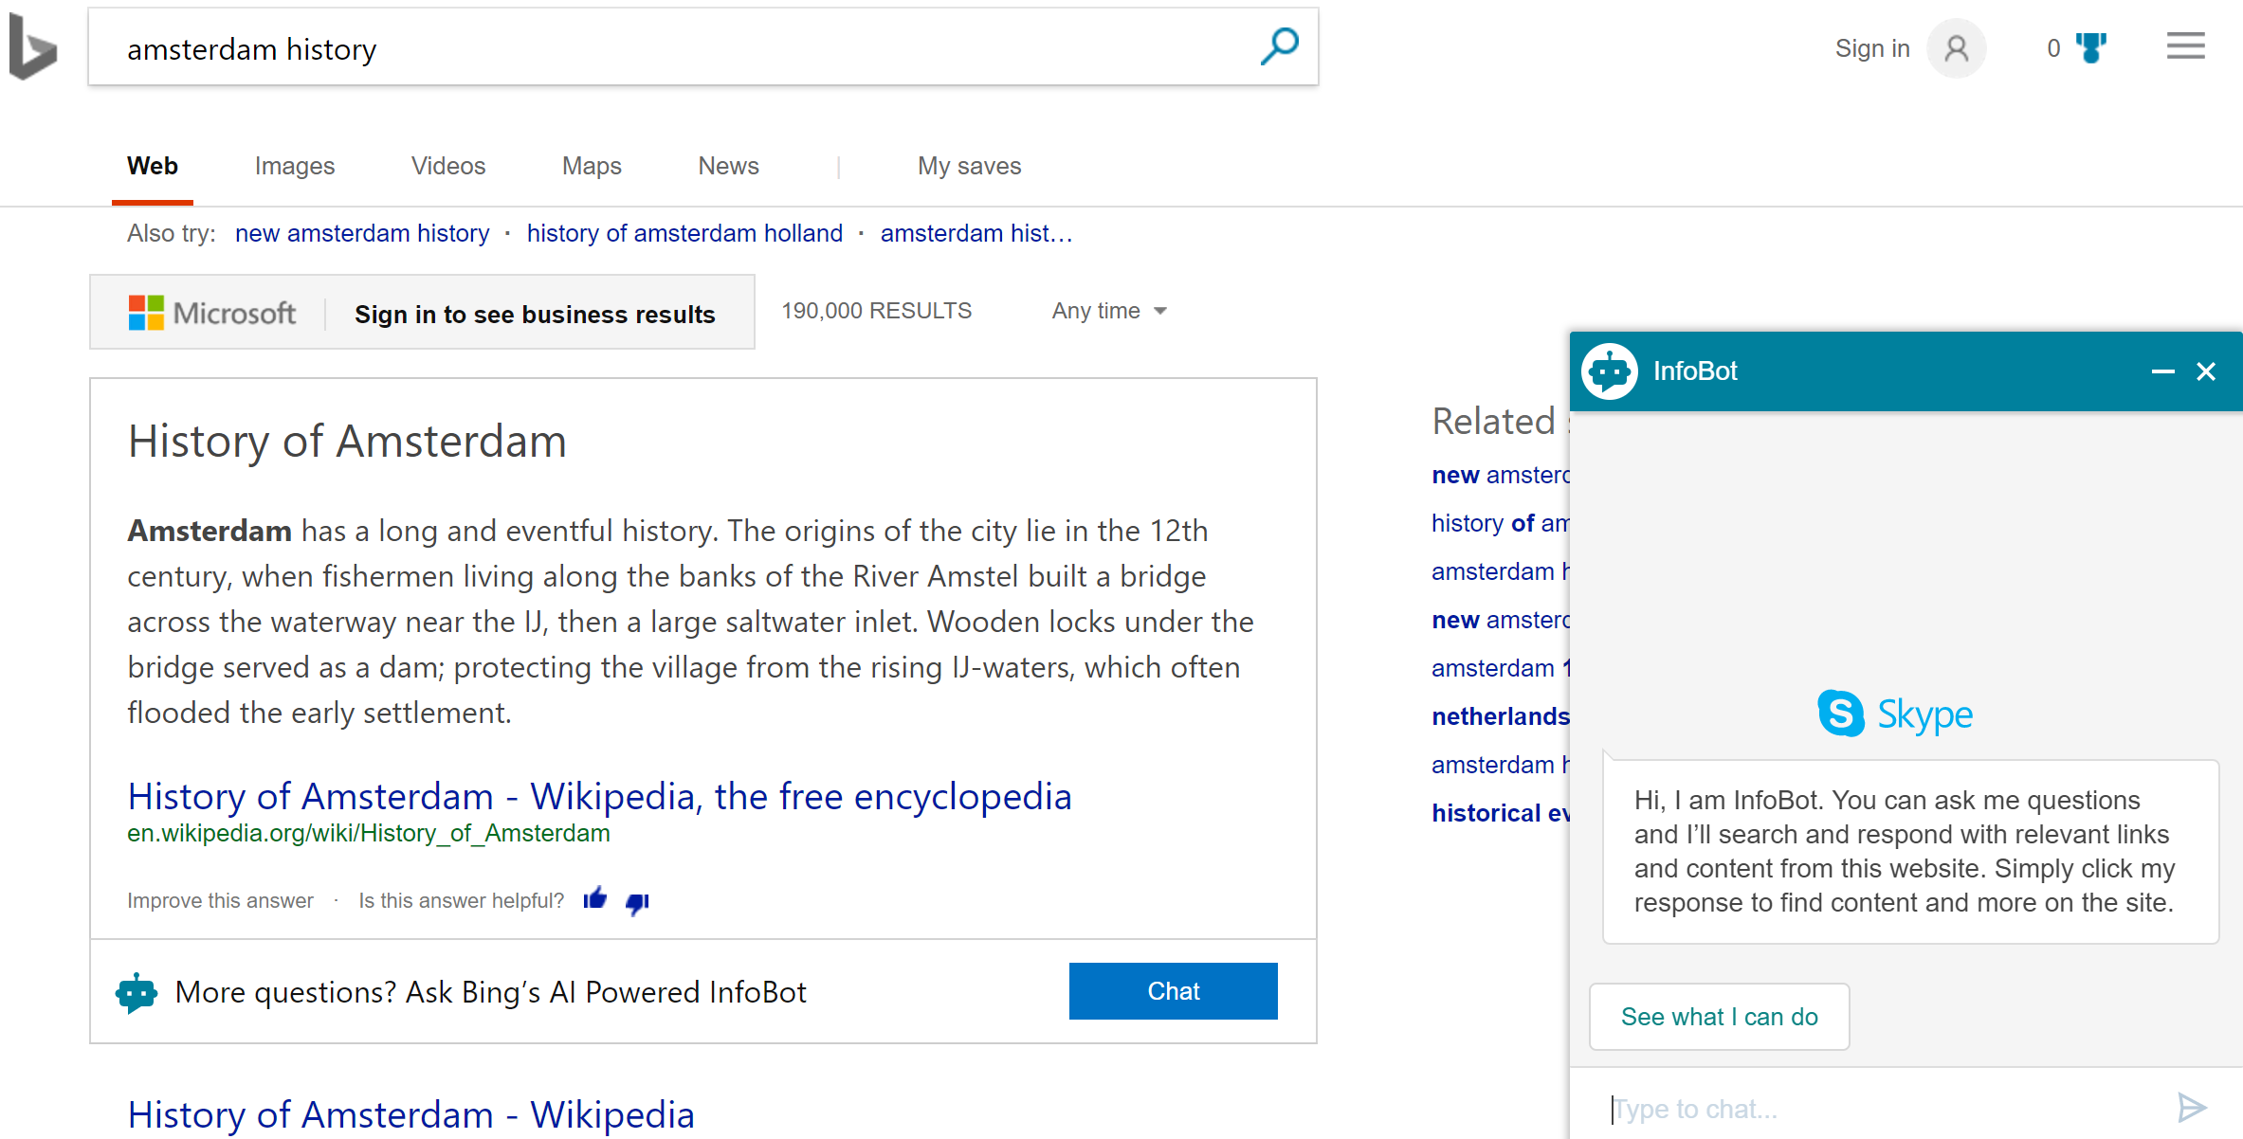
Demo

Slide 30
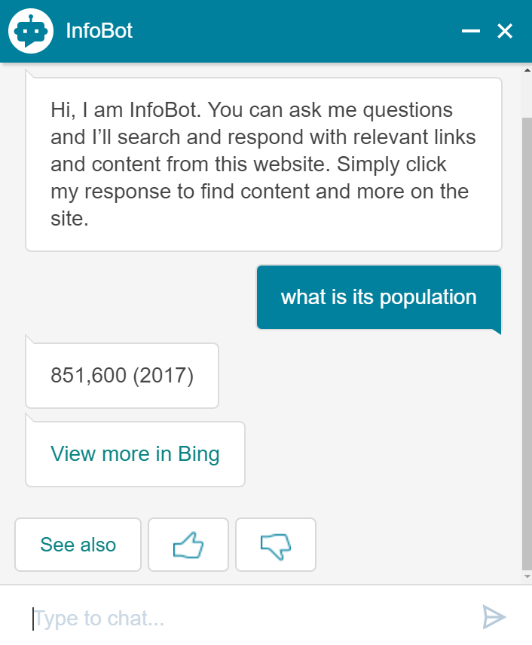
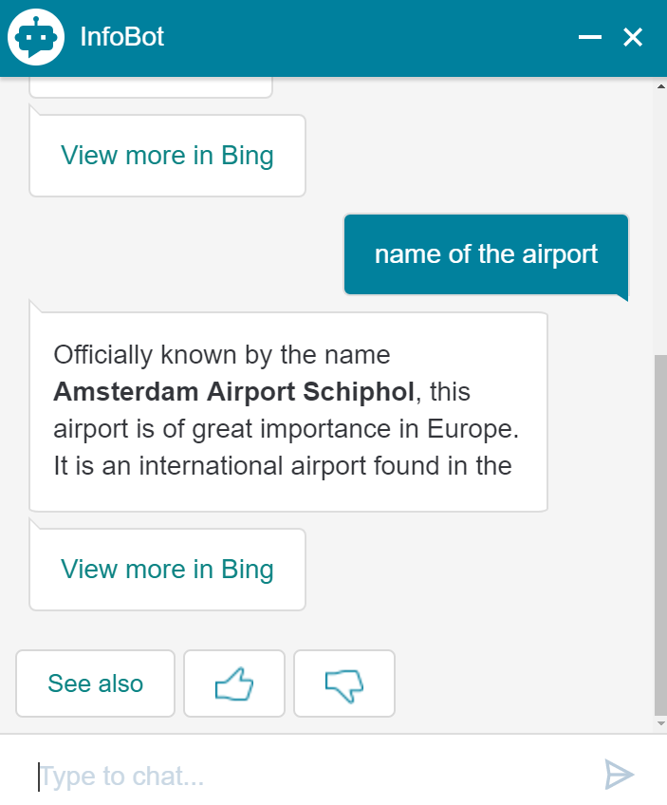
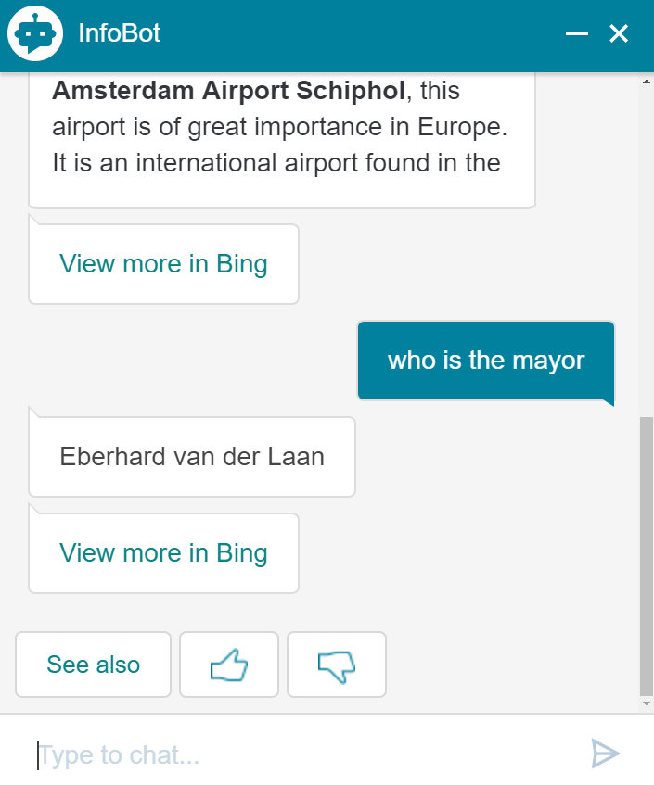
Demo

Slide 31
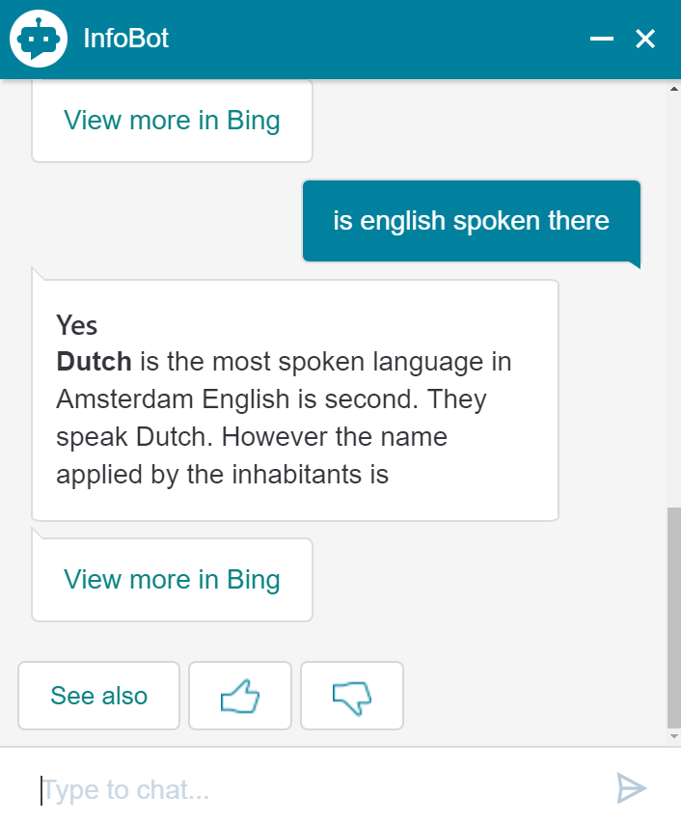
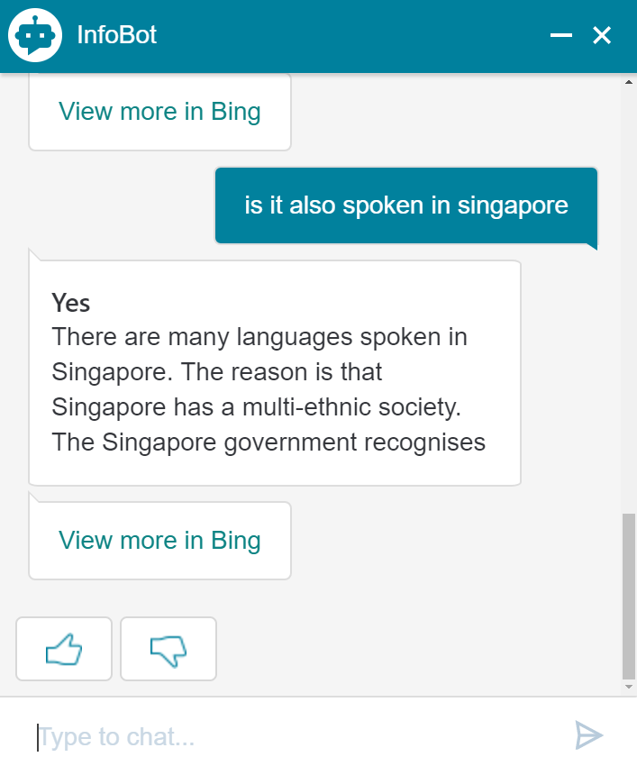
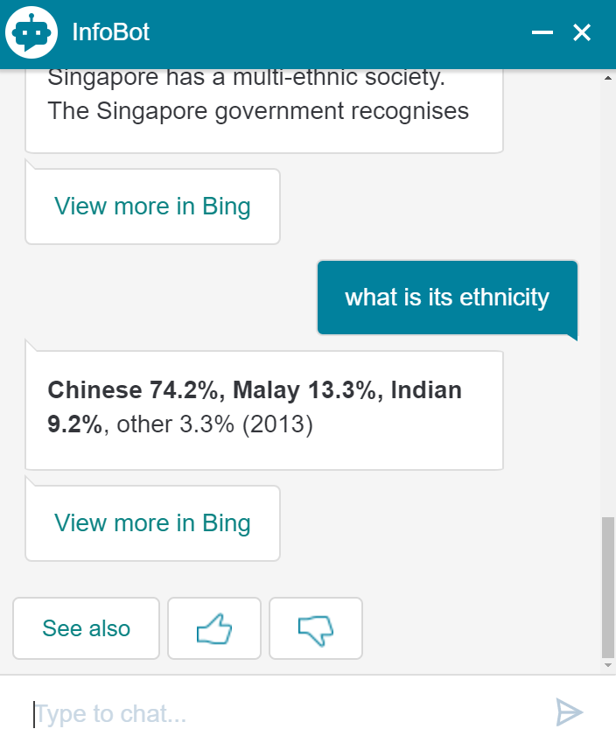
Demo

Slide 32
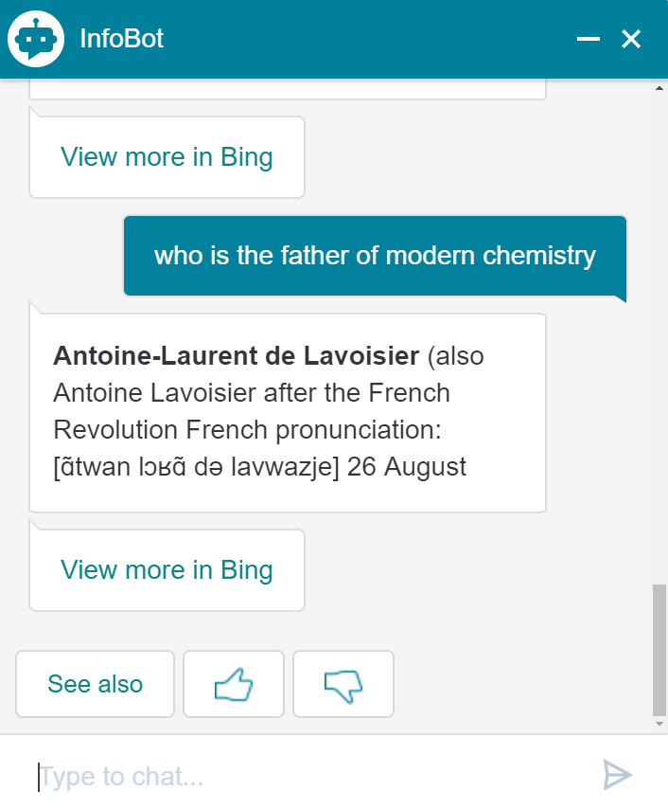
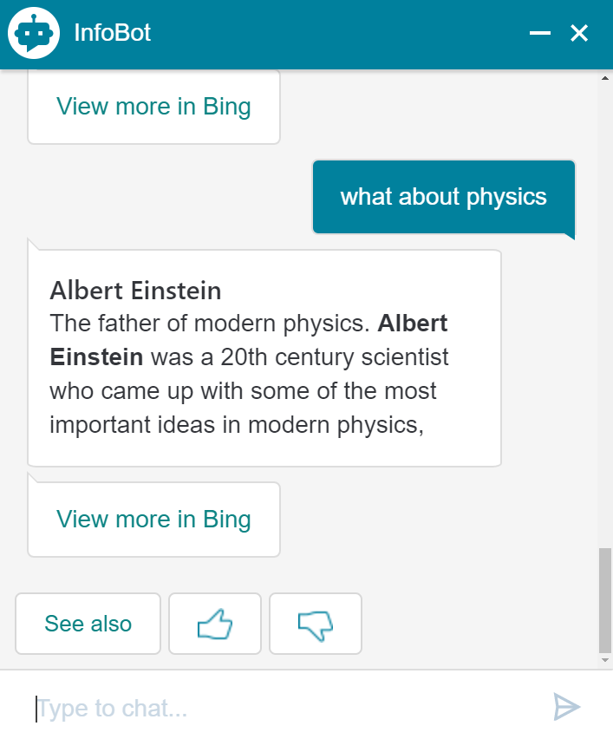
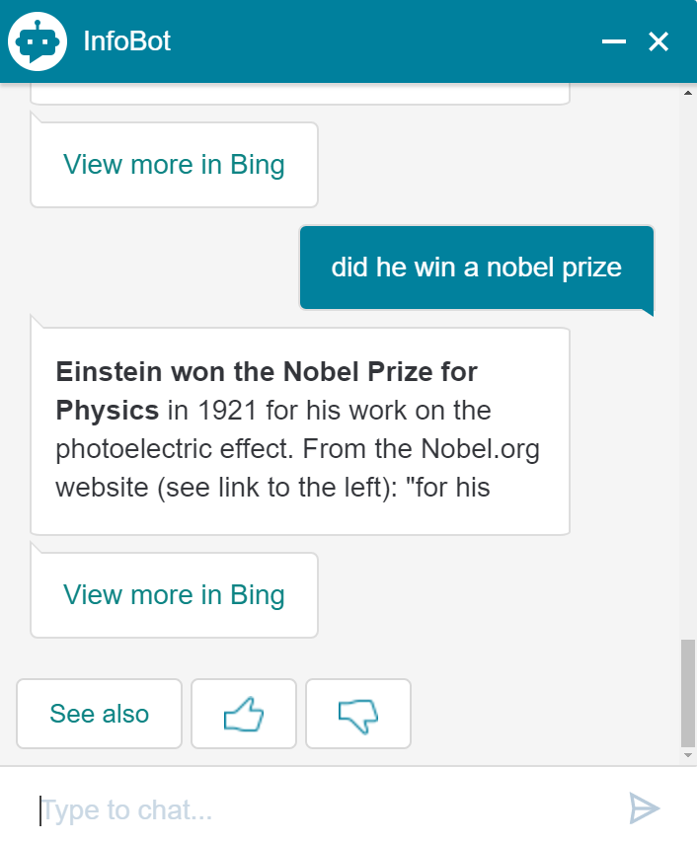
Demo

Slide 33
Search Powered Conversations
Two way conversations between questioner and respondent can help to satisfy questioner’s information need, and feel more natural
Ask questions back to user for disambiguation and exploration
Leverage web knowledge to have guided conversations with users

Slide 34
Conclusion
Question answering is important
Conversational question understanding system that can be easily plugged into different scenarios
Benefit of guided/two way conversations
Conversational technologies will become more and more prevalent
Conversational Question Understanding
Search Powered Conversations
🤖📱
💻🔈
🗣

Slide 35
We’re hiring!
Come chat if you have any questions!
You can send resume/cv to
gren@microsoft.com

Slide 36
Thank you!

Slide 37
Questions?

